Slide 1
Drew up a few possible ideas for the layouts of our poster. Slide 2 corresponds to a tri fold poster. On the left fold is an analysis of conventional geometries, right fold is unconventional geometries, and the center is overall presentation of what the Meissner effect is and our conclusions. Or Bradley had the idea of printing a poster from the EB (less work so I like it) in which case we would have a slightly different lay out but same general concept. Conventional on one part, unconventional on another, theoretical findings and mathematical analysis of the Meissner effect as a whole in the center.

Slide 2
Meissner effect mathematical calculations and general effects on distribution and propagation of electro-magnetic waves
Differences between conventional geometries and unconventional geometries in superconductors. Where our interest lies and the goal of our analysis
Conventional geometry diagrams/models
Unconventional geometries diagrams/models
Explanation of the model and how electro-magnetic waves propagate in superconductors with traditional symmetries.
Conclusion of our findings. Differences of superconducting materials of conventional geometries and unconventional geometries
Explanation of the unconventional geometries models and how electro-magnetic waves propagate in superconductors with untraditional symmetries

Slide 3
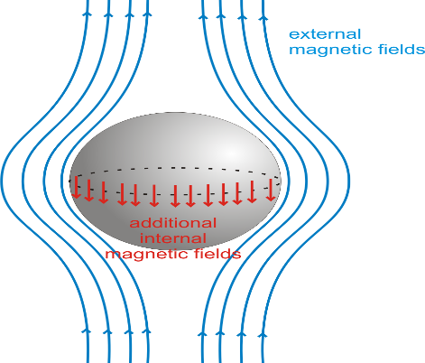
Mathematics and analysis of conventional geometries. Typical distribution and affect of the Meissner effect on superconductors
Meissner effect and its’ properties. Interest in this project and our goals. Explanation of our procedure and mathematical calculations of the Meissner effect.
Mathematics and analysis of unconventional geometries. How theoretically the geometry affects the Meissner effect and propagation of electro-magnetic waves.
Diagrams and models of conventional superconductors
Diagram/Model of unconventional geometry(a prism) and the Meissner effect.
Conclusion of how the Meissner effect affects superconducting material.
Conclusions of our analysis. How unique geometries affect propagation of electro-magnetic waves and the Meissner effect, how they differ from conventional thinking.
Conclusion of how unconventional geometries affect distribution of electro-magnetic waves in superconductors.

